Slide 1
Solution Quiz 2

Slide 2
Answer Q1
Yes, as we are assuming the message are identical and RSA is using same public and private key pair so signatures can be same.
Notes:
The threat of this type of spoofing is session hijacking and an attacker could bypass any authentication measures taken place to build the connection. This is accomplished by corrupting the DataStream of an established connection, then re-establishing it based on correct sequence and acknowledgement numbers with the attack machine.

Slide 3
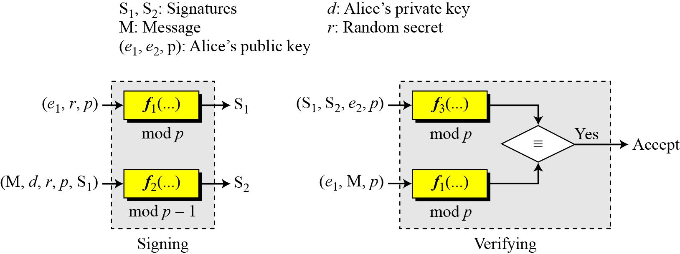
Answer Q2
The key generation procedure here is exactly the same as the one used in the cryptosystem. In ElGamal digital signature scheme, (e1, e2, p) is Alice’s public key; d is her private key.
However, in ElGamal scheme signatures are obtained using a a random secret r which can change for each message while the public and private key remains the same. As a result, we can have different signatures for every new message.
Notes:
Today, most OSs implement random sequence number generation, making it difficult to predict them accurately. If, however, the sequence number was compromised, data could be sent to the target.

Slide 4
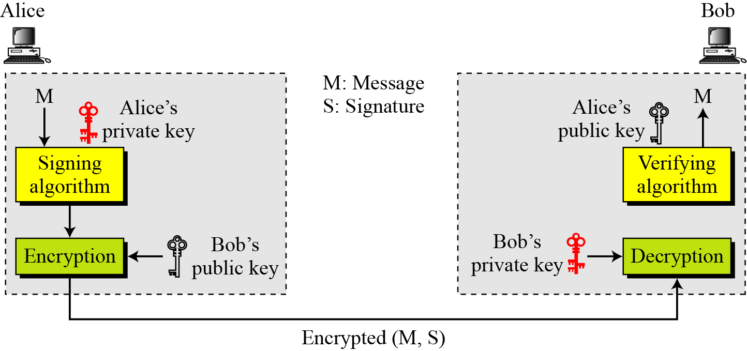
Answer Q3

